Slide 1

Bootstrap Jumbotron
Ranken Technical College

Slide 2
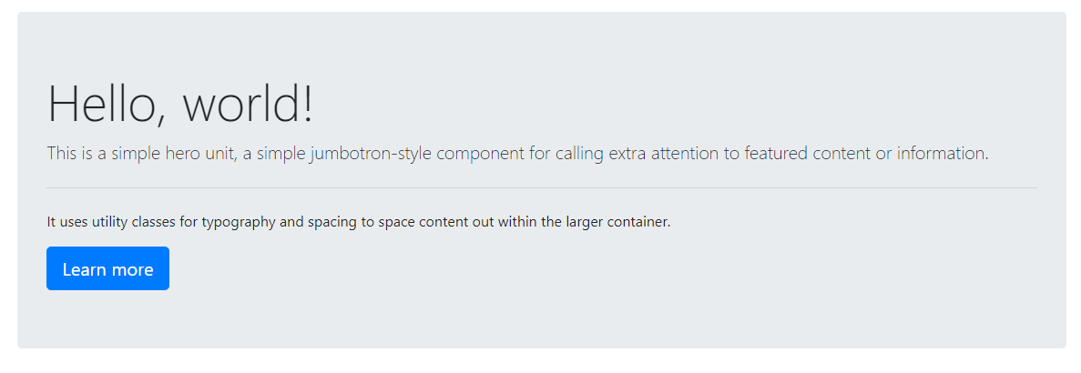
Jumbotron
A lightweight, flexible component to showcase key marketing messages on your site.
Sources
https://getbootstrap.com/docs/4.5/components/jumbotron/

Slide 3
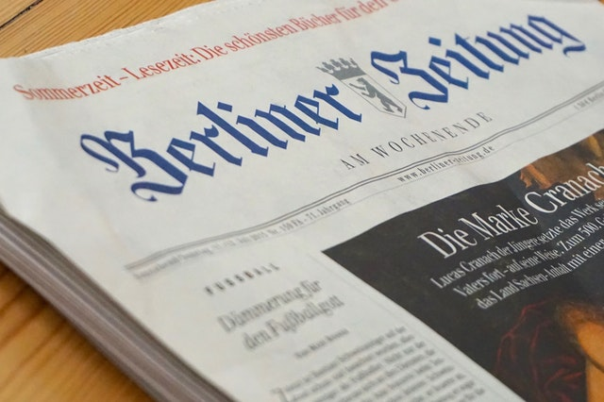
Above The Fold
in the analog world
Originated with newspapers.
Due to being printed on large sheets of paper, they were folded once when the they hit the news-stands.
This led to only the top half of the front page being visible to passersby.
Newspapers learned to present attention-grabbing headlines, content, and imagery on the top half of the page.
Sources
https://www.abtasty.com/blog/above-the-fold/

Slide 4
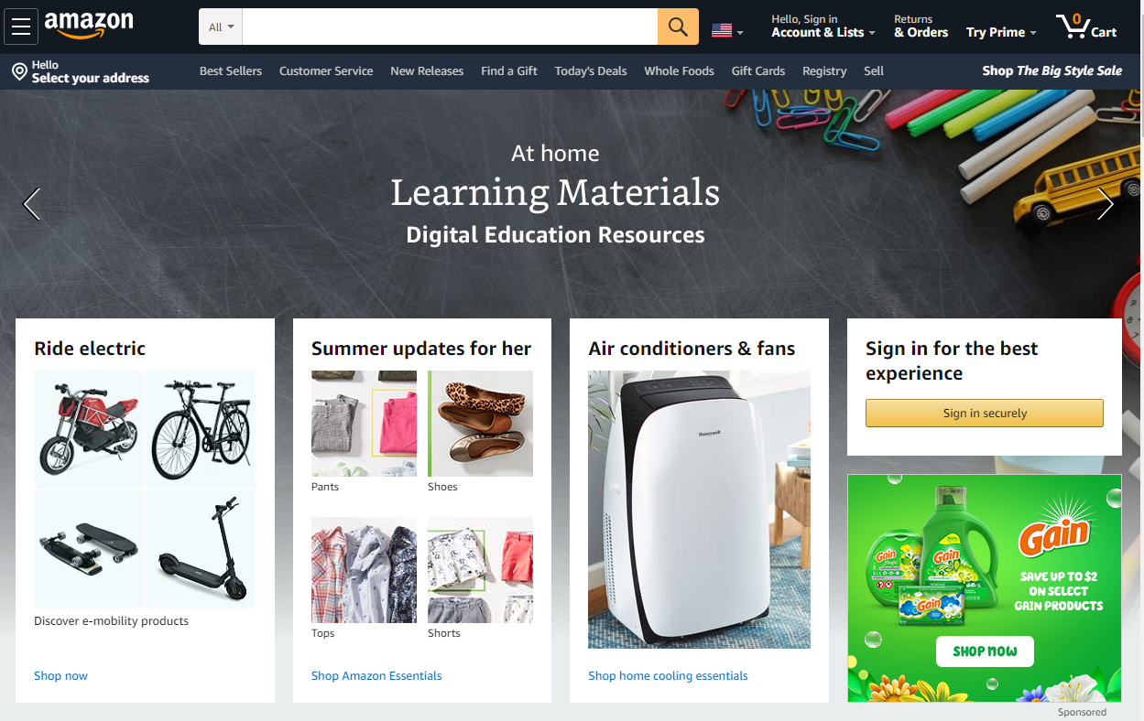
Above The Fold
in the digital world
This basic principle applies to digital content.
The fold relates to the scrollbar.
Anything that isn't visible immediately, that requires scrolling, is considered below the fold.
The fold is generally 400-600 pixels from the top of the viewport.
You can use vh to be more precise if needed.
Sources
https://www.abtasty.com/blog/above-the-fold/
https://www.optimizely.com/optimization-glossary/above-the-fold/

Slide 5
The Conversion Funnel
and calls to action
Get your user's attention. (SEO, ads, marketing, etc.)
Pique their interest. (attractive visuals, video content, quick summaries, etc.)
Build a relationship of trust and the desire to buy. (product comparisons, case studies, testimonial, pricing, cause, history, etc.)
Give them an action to take. (purchase, subscribe, etc.)
Sources
https://www.abtasty.com/blog/ecommerce-conversion-funnel/
https://www.abtasty.com/blog/effective-call-to-action/
https://www.abtasty.com/blog/above-the-fold/

Slide 6
Lessons Learned
Present attention-grabbing headlines, content, and imagery above the fold of the home page.
Use large font sizes above the fold.
Use background images and/or gradients above the fold.
Use animated graphics and video above the fold.
Give a Call To Action somewhere on the home page.
Sources
https://www.abtasty.com/blog/above-the-fold/
https://www.abtasty.com/blog/effective-call-to-action/

Slide 7

Simple Jumbotron
<div class="container">
<div class="jumbotron bg-dark text-white">
<h1 class="display-4">20% off store wide!</h1>
<a class="btn btn-primary btn-lg" role="button" href="#">Learn more</a>
</div>
</div>

Slide 8

Full-Width Jumbotron
<div class="jumbotron jumbotron-fluid bg-dark text-white">
<div class="container">
<h1 class="display-4">20% off store wide!</h1>
<a class="btn btn-primary btn-lg" role="button" href="#">Learn more</a>
</div>
</div>

Slide 9
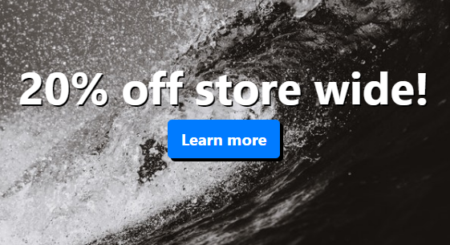
Jumbotron with background image
HTML
<div class="jumbotron jumbotron-fluid example-jumbotron">
<h1 class="display-4">20% off store wide!</h1>
<a class="btn btn-primary btn-lg" role="button" href="#">Learn more</a>
</div>
CSS
.example-jumbotron {
color: white;
background-image: url('...');
background-repeat: no-repeat;
background-position: center;
background-size: cover;
min-height: 400px;
display: flex;
flex-direction: column;
justify-content: center;
align-items: center;
}
.example-jumbotron h1 {
font-weight: bolder;
text-shadow: 2px 2px black;
}
.example-jumbotron .btn {
font-weight: bolder;
box-shadow: 4px 4px black;
}

Slide 10
More Examples
https://getbootstrap.com/docs/4.5/components/jumbotron/

